Slide 1

Compiler Design
Divyaprabha K N
Assistant Professor,
Department of Computer Science & Engineering

Slide 2

COMPILER DESIGN: UNIT 1
Challenges in Lexical Analyzer
Divyaprabha K N
Department of Computer Science & Engineering

Slide 3

Compiler Design Lecture Overview
We will learn about:
Challenges in scanning in different languages
C Language Grammar

Slide 4
Compiler Design
Challenge : Scanning is hard
Example 1: In Fortran, whitespace is insignificant:
VAR1 is exactly the same as VA R1
Fortran idea: removing all the whitespace should not change the meaning of the program.
Loop example
DO 5 I = 1,25 Here DO is a keyword representing a loop (similar to FOR in C), I = 1,25 represents that the iteration variable I ranges from 1..25. The number 5 represents that the loop extends from the DO statement till the statement with label 5, including all statements that are in between.
Another example:
DO 5 I = 1.25 The only difference in this code from the previous code is the replacement of , with .. This simply means that the variable DO5I = 1.25, i.e., a variable has been assigned an integer (there is no loop). The problem is that just by looking at the first three characters, I cannot tell whether DO is a keyword or a prefix of a variable name. Hence we need a lookahead. In this example, a large lookahead is required. Ideally, the language design should ensure that the lookahead is small.

Slide 5
Compiler Design
Challenge : Scanning is hard
Lookahead is always required
Lookahead may be required to decide where one token ends and the next token begins. We would like to minimize lookahead
For example, when we read the first character of the keyword else, we need to lookahead to decide whether it is an identifier or a keyword. Similarly, we need lookahead to disambiguate between == and =.
PL/1 keywords are not reserved.
Example 2: When keywords are used as identifiers.
This makes lexical analysis a bit more difficult -- need to decide what is a variable name and what is a keyword, and so need to look at what's going on in the rest of the expression.

Slide 6
Compiler Design
Challenge : Scanning is hard
Example 3 : Different uses of the same character >,< in C++
Template syntax: a<b>
Stream syntax: cin>>var;
Binary right shift syntax: a>>4
Nested Template : A<B<C>>D;

Slide 7
Compiler Design Syntactic Sugar
Syntactic Sugar : Syntax is designed to make things easier to read or express. Example:
In C : a[i] is a syntactic sugar for *(a+i)
In C : a+=b is equivalent to a = a + b
In C# : var x = expr (compiler deduces type of x from expr)
Compilers expand sugared constructs into fundamental constructs (Desugaring).

Slide 8

Compiler Design Lexer Feedback
C and C++ Lexers require lexical feedback to differentiate between typedef names and identifiers.

Slide 9
Compiler Design
Challenge : Scanning is hard
Example 4: Scanning in Python - When Scope is handled using whitespace.
This requires whitespace tokens - Special tokens inserted to indicate changes in levels of indentation.
NEWLINE marks the end of a line.
INDENT indicates an increase in indentation.
DEDENT indicates a decrease in indentation.
Note that INDENT and DEDENT encode change in indentation, not the total amount of indentation.
Reference: https://docs.python.org/3/reference/lexical_analysis.html

Slide 10
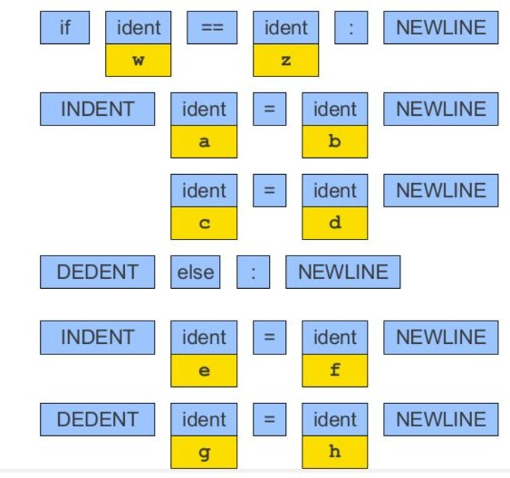
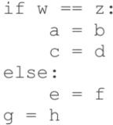
Compiler Design
Challenge : Scanning is hard
Example 4: Scanning in python (cont.)

Slide 11
THANK YOU
Divyaprabha K N
Department of Computer Science & Engineering
divyaprabha@pes.edu

